Slide 1
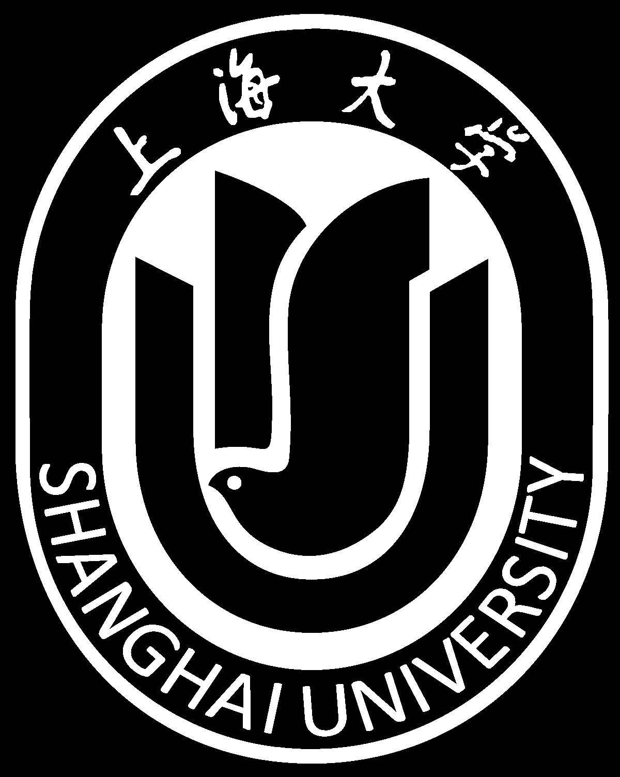
Lecture 7 Sampling（采样）
School of Computer Engineering and Science
Shanghai University
Instructor: Jianjia Wang, Shan Ouyang

Slide 2
Outline: Lecture 7: Sampling
Introduction
The Sampling Theorem
Impulse train sampling
Sampling with a zero-order hold
Interpolation
Aliasing

Slide 3
Outline: Lecture 7: Sampling
Introduction
The Sampling Theorem
Impulse train sampling
Sampling with a zero-order hold
Interpolation
Aliasing

Slide 4
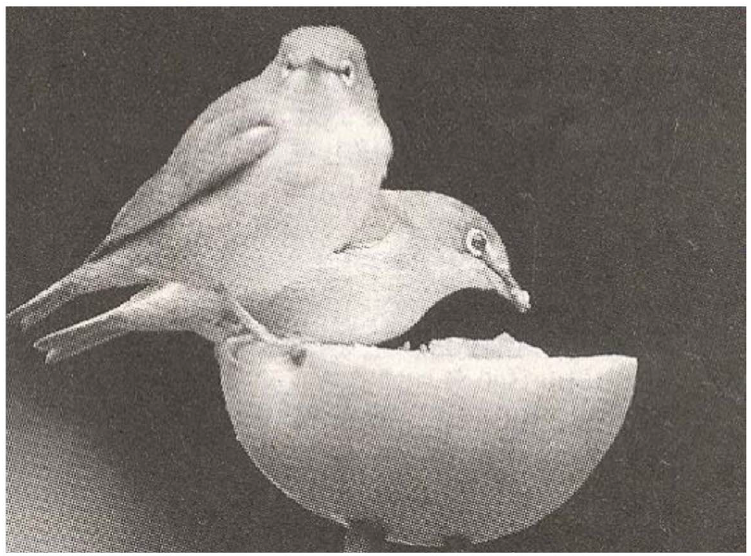
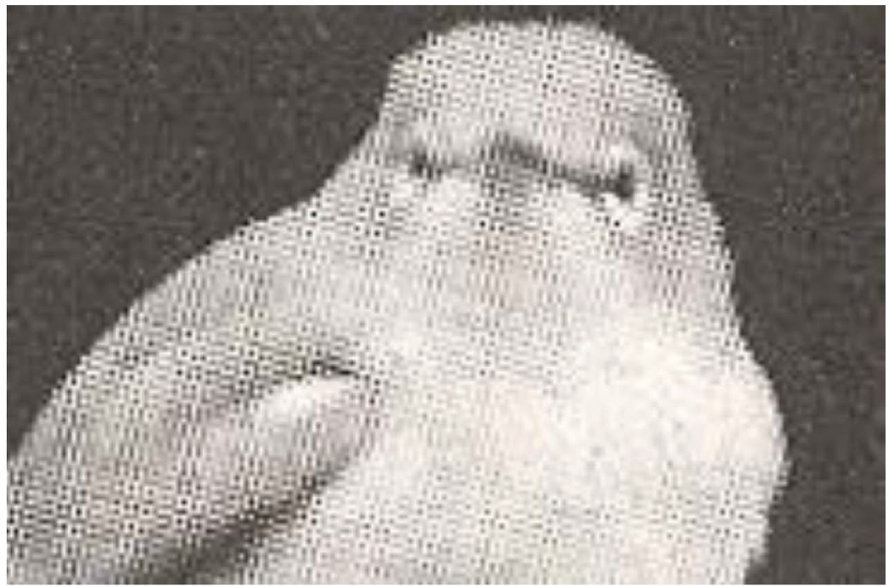
Introduction
Continuous-time signal is often represented by discrete-time signal:
连续时间信号通常由离散时间信号表示：
- Image transmission in fax machine;
- Signals in TV display: 60Hz or beyond refresh rates;
- Film: 12 or beyond frames per second.
Zoom in

Slide 5
Introduction
Motivation: a discrete-time represented continuous-time signal can be digitally handled, using computers:
动机:用离散时间表示连续时间信号可以用计算机进行数字处理:
- Accurate, programmable, flexible, reproducible, powerful;
- Compatible to digital networks and relevant technologies;
- All signals look the same when digitized, except at different rates, and thus can be supported by the same network.
Question: under which conditions can a continuous-time signal be uniquely specified by its discrete-time samples?

Slide 6
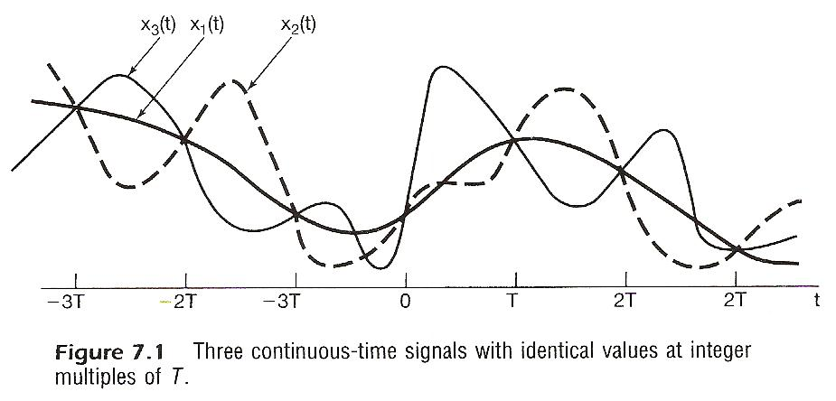
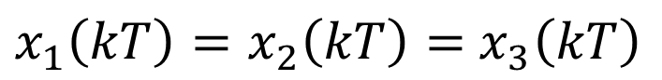
Introduction
Question: under which conditions can a continuous-time signal be uniquely specified by its discrete-time samples?在什么条件下，连续时间信号可以由其离散时间样本单独指定？
$x_{1}\left(kT\right)=x_{2}\left(kT\right)=$ $x_{3}\left(kT\right)$

Slide 7
Introduction
Question: under which conditions can a continuous-time signal be uniquely specified by its discrete-time samples?
For a given set of samples, it might be produced by different continuous-time signals.对于给定的样本集，它可能由不同的连续时间信号生成。
But if a continuous-time signal is sampled in a relatively high frequency, can the samples be used to represent the signal? How high should the sampling frequency be?

Slide 8
Outline: Lecture 7: Sampling
Introduction
The Sampling Theorem
Impulse train sampling
Sampling with a zero-order hold
Interpolation
Aliasing

Slide 9
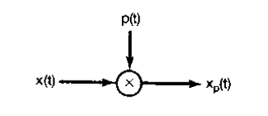
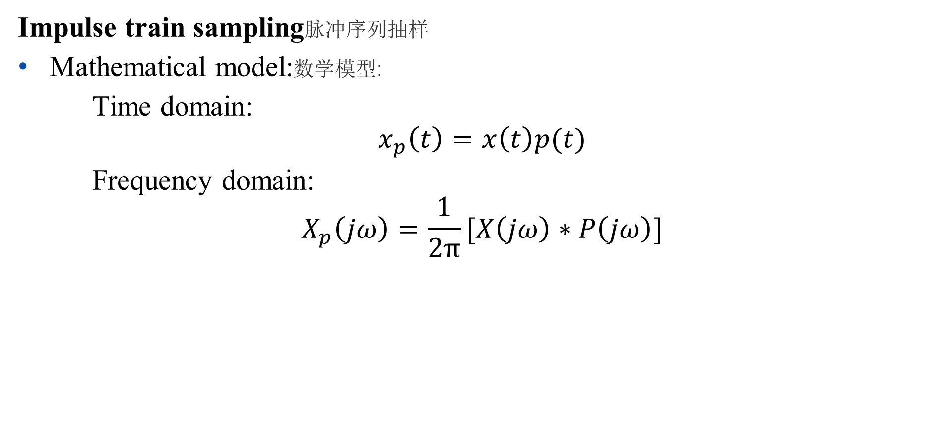
The Sampling Theorem
Impulse train sampling脉冲序列抽样
Mathematical model:数学模型:
Time domain:
$$x_{p}\left(t\right)=x\left(t\right)p(t)$$
Frequency domain:
$$X_{p}\left(jω\right)=\frac{1}{2π}[X\left(jω\right)∗P\left(jω\right)]$$

Slide 10
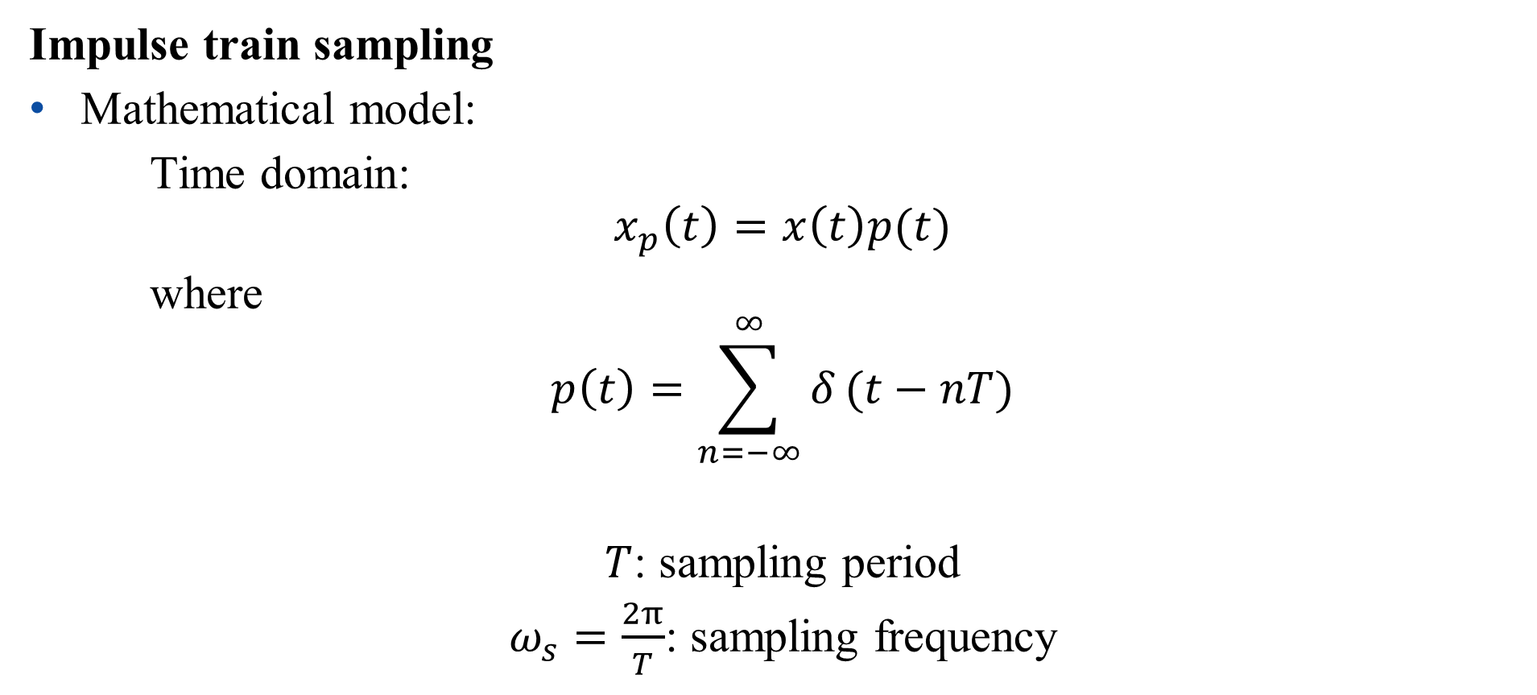
The Sampling Theorem
Impulse train sampling
Mathematical model:
Time domain:
$$x_{p}\left(t\right)=x\left(t\right)p(t)$$
where
$$p\left(t\right)=\sum_{n=−∞}^{∞}{δ}(t−nT)$$
$T$: sampling period
$ω_{s}=\frac{2π}{T}$: sampling frequency

Slide 11
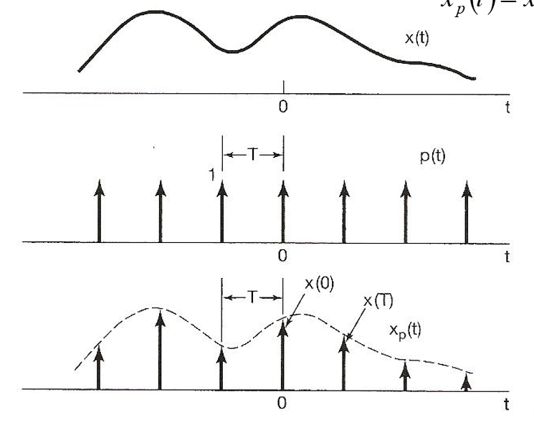
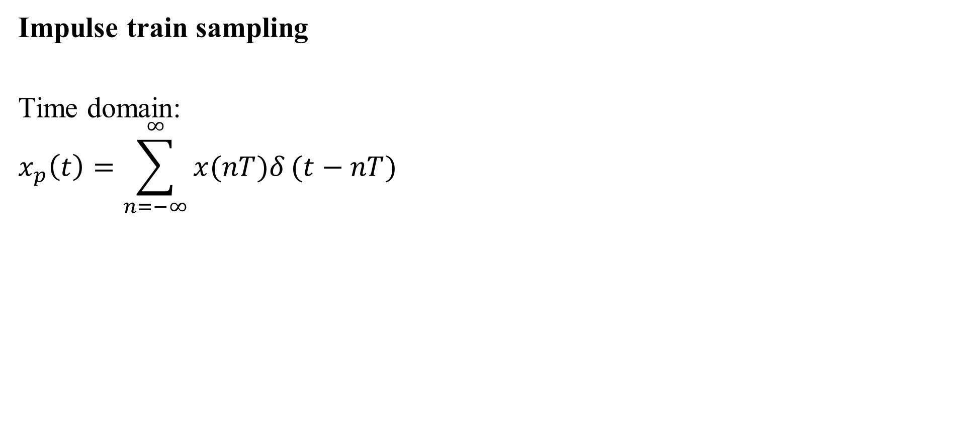
The Sampling Theorem
Impulse train sampling
Time domain:
$$x_{p}\left(t\right)=\sum_{n=−∞}^{∞}{x(nT)δ}(t−nT)$$

Slide 12
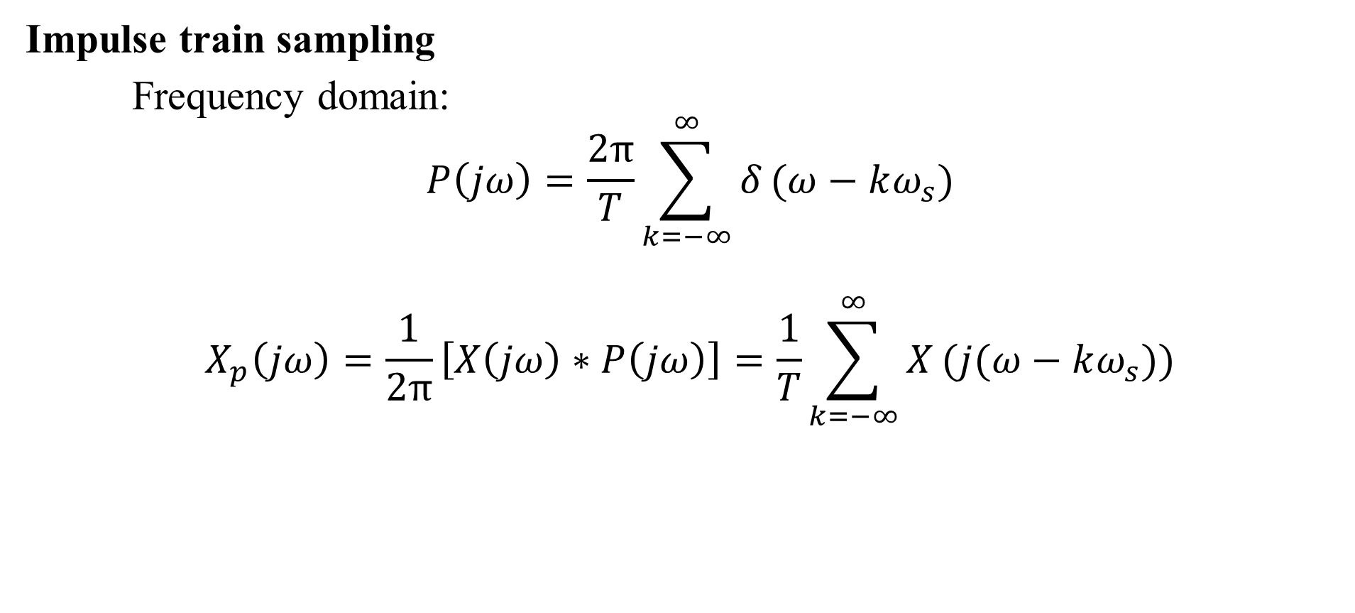
The Sampling Theorem
Impulse train sampling
Frequency domain:
$$P\left(jω\right)=\frac{2π}{T}\sum_{k=−∞}^{∞}{δ}(ω−kω_{s})$$
$$X_{p}\left(jω\right)=\frac{1}{2π}\left[X\left(jω\right)∗P\left(jω\right)\right]=\frac{1}{T}\sum_{k=−∞}^{∞}{X}(j(ω−kω_{s}))$$

Slide 13
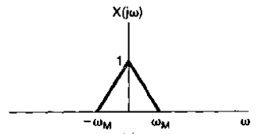
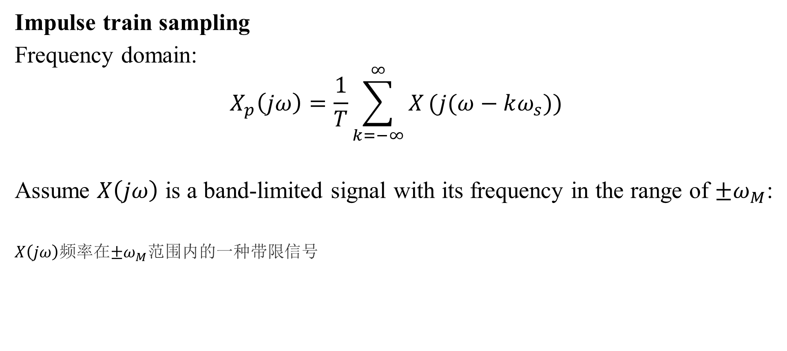
The Sampling Theorem
Impulse train sampling
Frequency domain:
$$X_{p}\left(jω\right)=\frac{1}{T}\sum_{k=−∞}^{∞}{X}(j(ω−kω_{s}))$$
Assume $X\left(jω\right)$ is a band-limited signal with its frequency in the range of $±ω_{M}$:
$X\left(jω\right)$频率在$±ω_{M}$范围内的一种带限信号

Slide 14
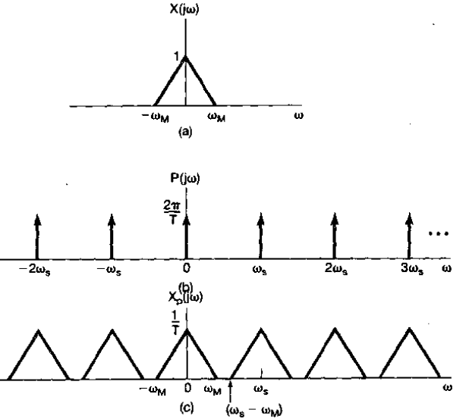
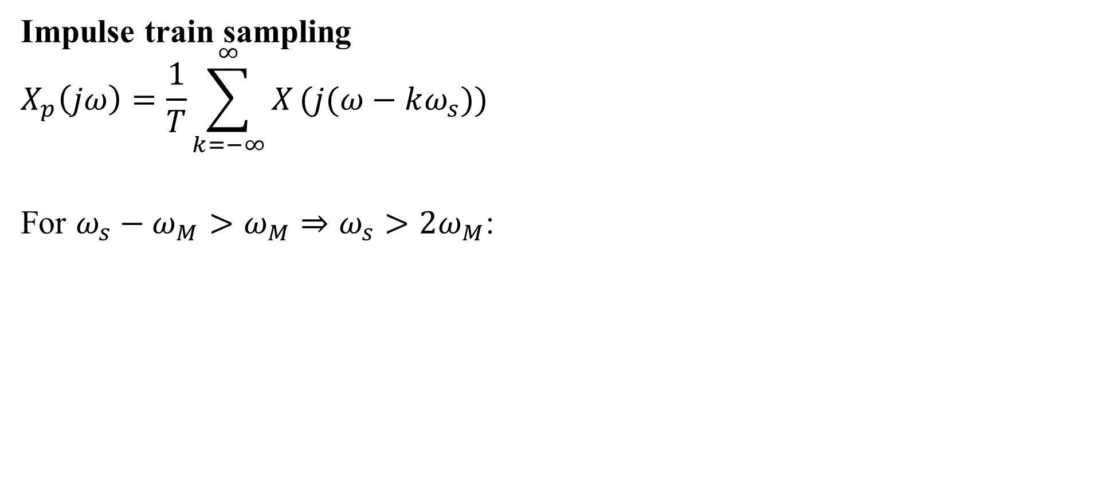
The Sampling Theorem
Impulse train sampling
$$X_{p}\left(jω\right)=\frac{1}{T}\sum_{k=−∞}^{∞}{X}(j(ω−kω_{s}))$$
For $ω_{s}−ω_{M}>ω_{M}⇒ω_{s}>2ω_{M}$:

Slide 15
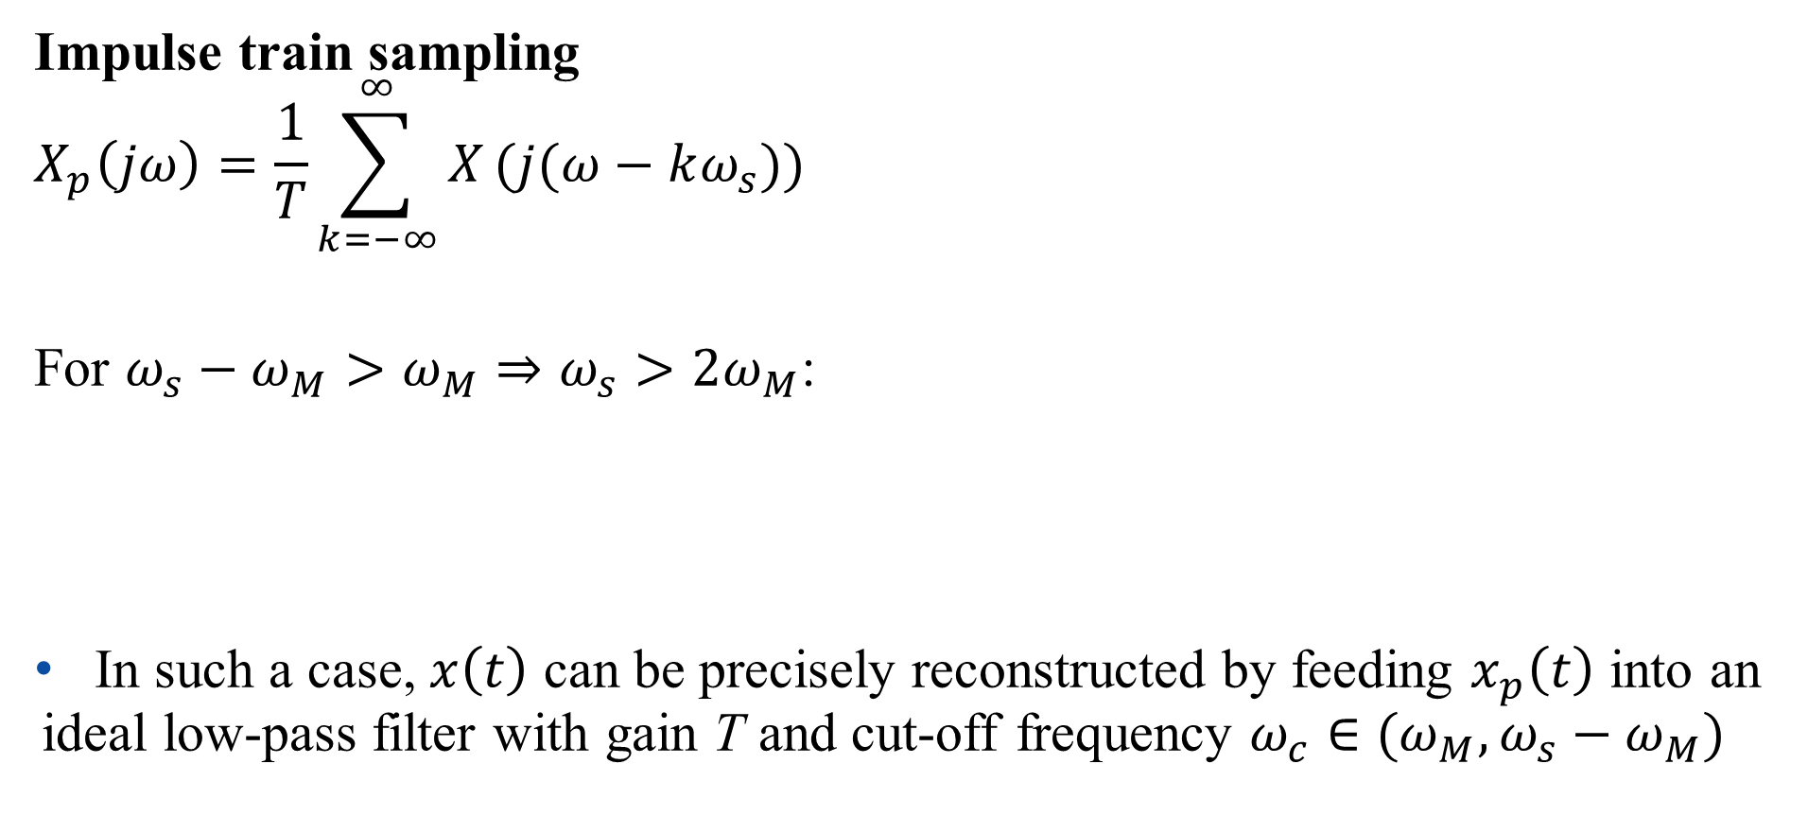
The Sampling Theorem
Impulse train sampling
$$X_{p}\left(jω\right)=\frac{1}{T}\sum_{k=−∞}^{∞}{X}(j(ω−kω_{s}))$$
For $ω_{s}−ω_{M}>ω_{M}⇒ω_{s}>2ω_{M}$:
In such a case, $x\left(t\right)$ can be precisely reconstructed by feeding $x_{p}\left(t\right)$ into an ideal low-pass filter with gain T and cut-off frequency $ω_{c}∈(ω_{M},ω_{s}−ω_{M})$

Slide 16
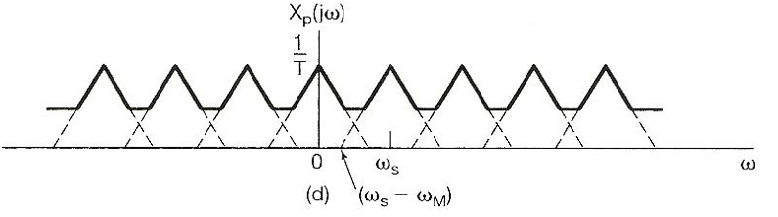
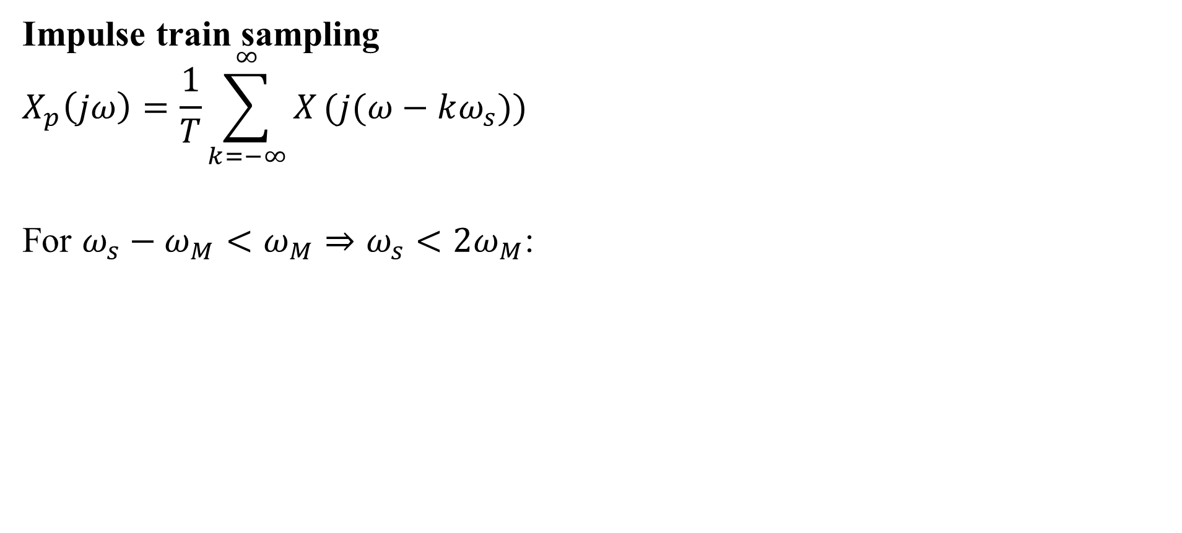
The Sampling Theorem
Impulse train sampling
$$X_{p}\left(jω\right)=\frac{1}{T}\sum_{k=−∞}^{∞}{X}(j(ω−kω_{s}))$$
For $ω_{s}−ω_{M}<ω_{M}⇒ω_{s}<2ω_{M}$:

Slide 17
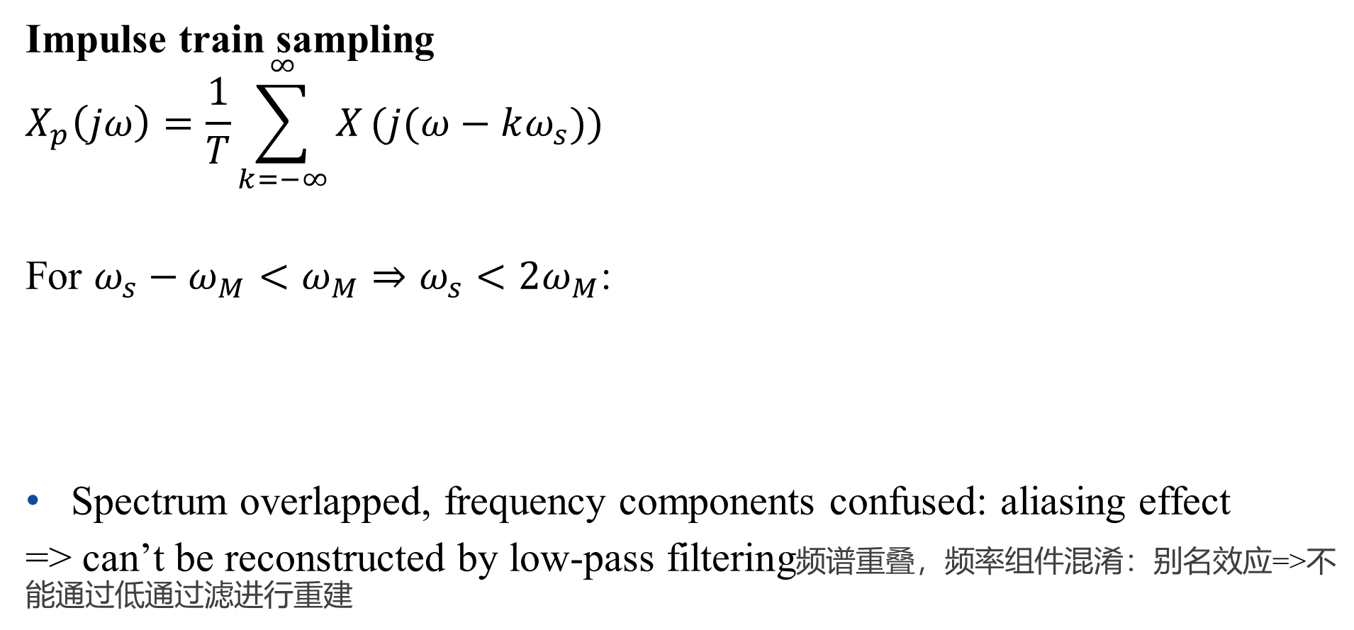
The Sampling Theorem
Impulse train sampling
$$X_{p}\left(jω\right)=\frac{1}{T}\sum_{k=−∞}^{∞}{X}(j(ω−kω_{s}))$$
For $ω_{s}−ω_{M}<ω_{M}⇒ω_{s}<2ω_{M}$:
Spectrum overlapped, frequency components confused: aliasing effect
=> can’t be reconstructed by low-pass filtering频谱重叠，频率组件混淆：别名效应=>不能通过低通过滤进行重建

Slide 18
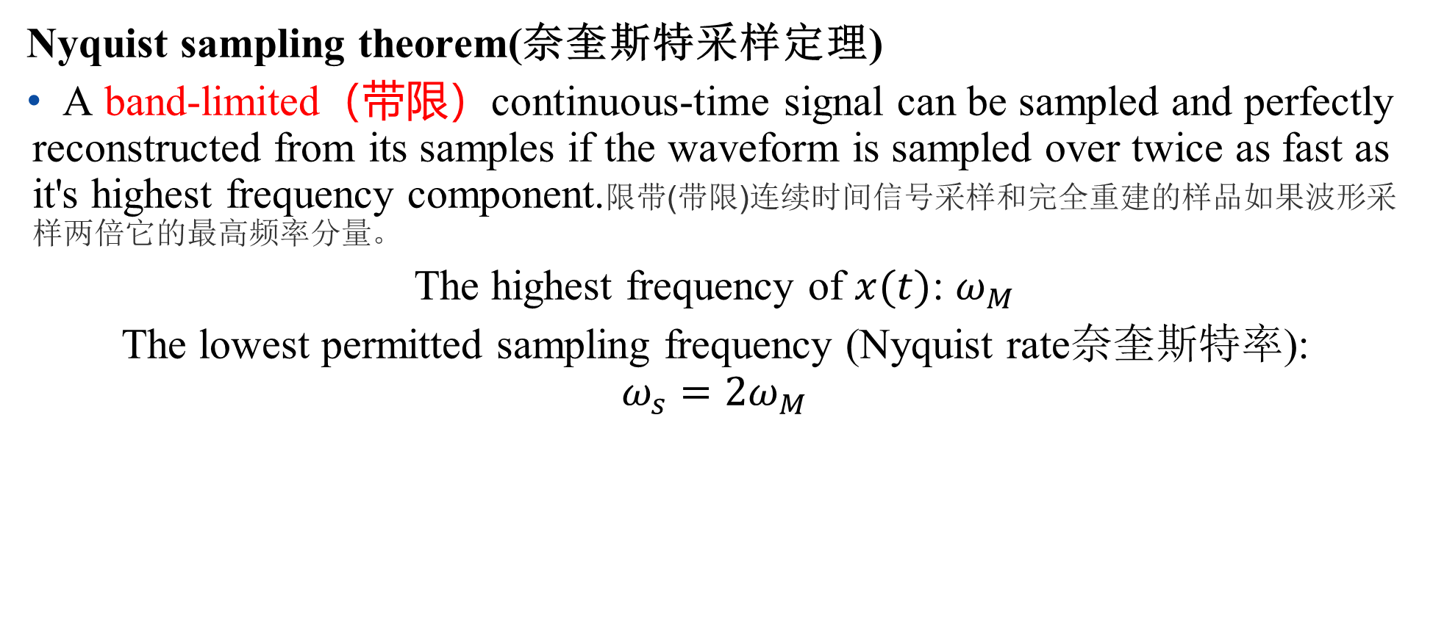
The Sampling Theorem
Nyquist sampling theorem(奈奎斯特采样定理)
A band-limited（带限）continuous-time signal can be sampled and perfectly reconstructed from its samples if the waveform is sampled over twice as fast as it's highest frequency component.限带(带限)连续时间信号采样和完全重建的样品如果波形采样两倍它的最高频率分量。
The highest frequency of $x(t)$: $ω_{M}$
The lowest permitted sampling frequency (Nyquist rate奈奎斯特率):
$$ω_{s}=2ω_{M}$$

Slide 19
The Sampling Theorem
Practical issues
Application of non-ideal low-pass filters for signal reconstruction:
应用非理想低通滤镜进行信号重建
- non-ideal low-pass filters need be accurate enough determined by acceptable level of distortion
非理想低通滤镜需要足够准确，由可接受的失真程度确定
In practice, signals might not be band-limited:
- pre-filtering

Slide 20
Outline: Lecture 7: Sampling
Introduction
The Sampling Theorem
Impulse train sampling
Sampling with a zero-order hold
Interpolation
Aliasing

Slide 21
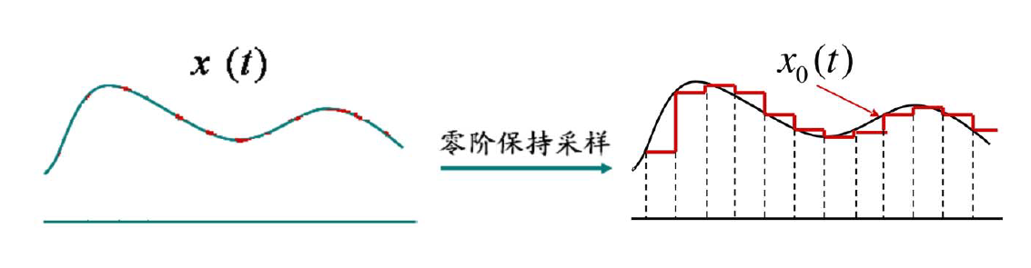
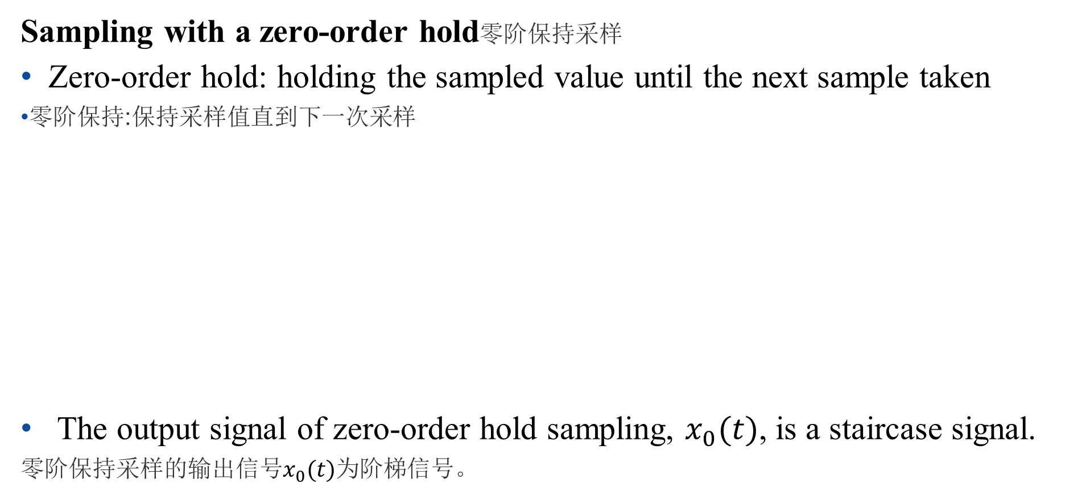
The Sampling Theorem
Sampling with a zero-order hold零阶保持采样
Zero-order hold: holding the sampled value until the next sample taken
零阶保持:保持采样值直到下一次采样
The output signal of zero-order hold sampling, $x_{0}(t)$, is a staircase signal.
零阶保持采样的输出信号$x_{0}(t)$为阶梯信号。
Sampling with zero-order hold

Slide 22
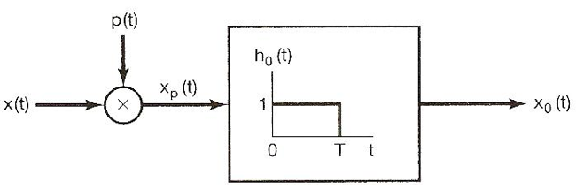
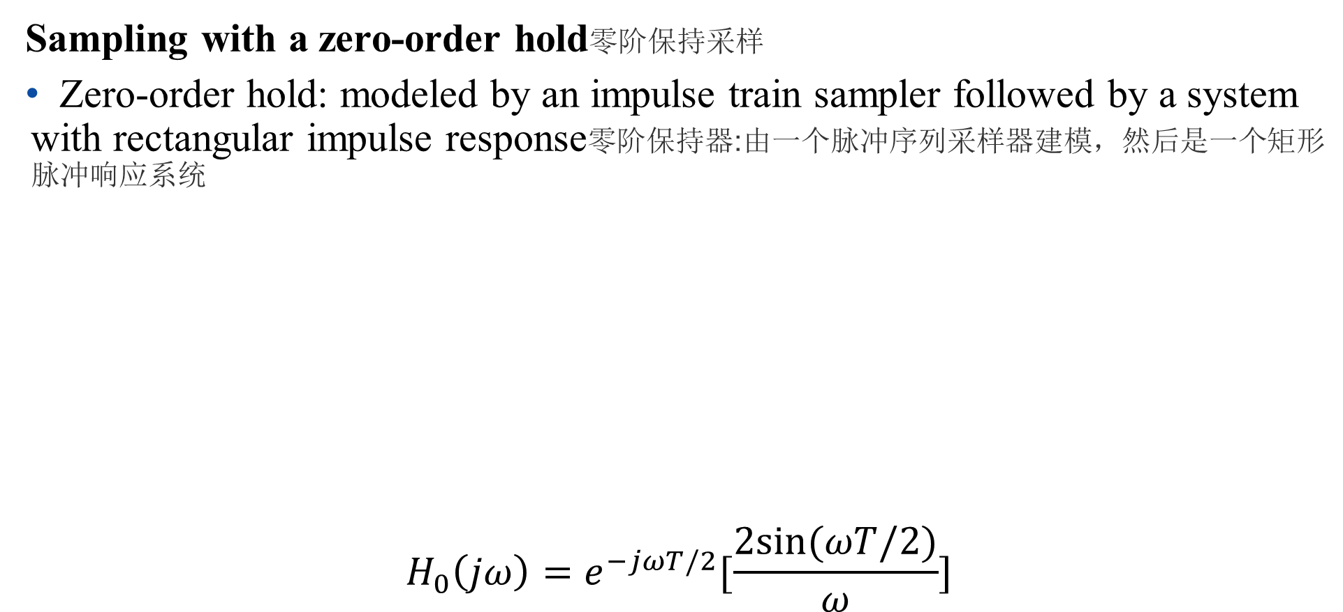
The Sampling Theorem
Sampling with a zero-order hold零阶保持采样
Zero-order hold: modeled by an impulse train sampler followed by a system with rectangular impulse response零阶保持器:由一个脉冲序列采样器建模，然后是一个矩形脉冲响应系统
$$H_{0}\left(jω\right)=e^{−jωT/2}[\frac{2sin⁡(ωT/2)}{ω}]$$

Slide 23
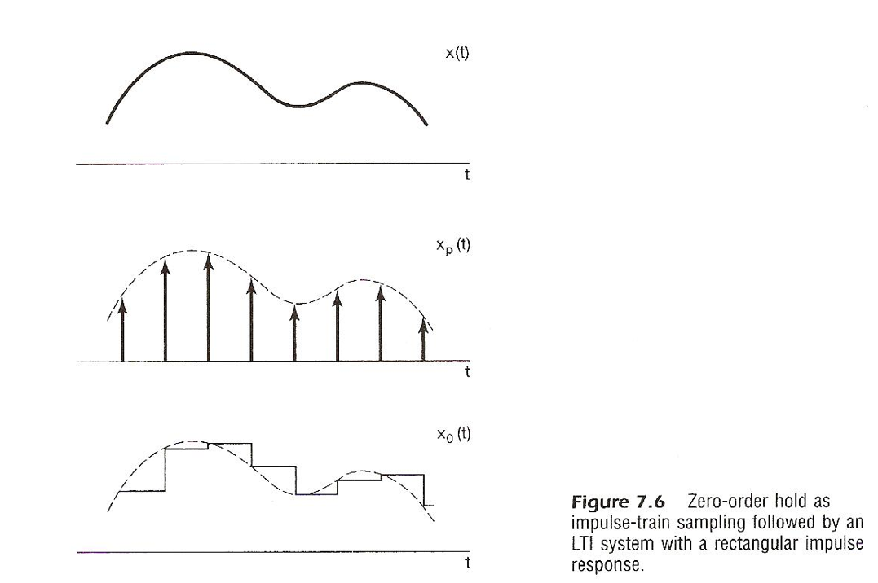
The Sampling Theorem
Sampling with a zero-order hold
Zero-order hold: modeled by an impulse train sampler followed by a system with rectangular impulse response零阶保持器:由一个脉冲序列采样器建模，然后是一个矩形脉冲响应系统

Slide 24
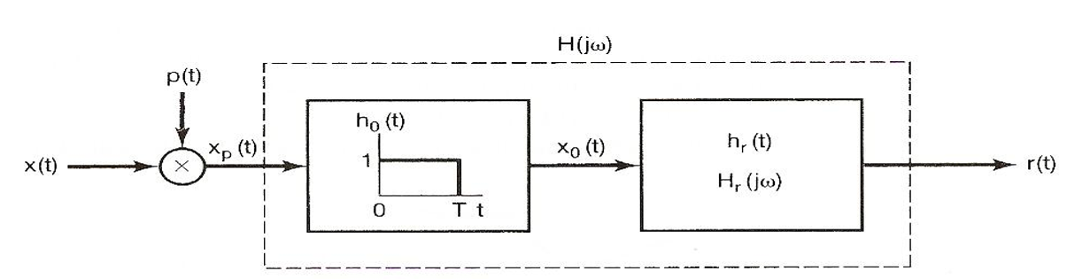
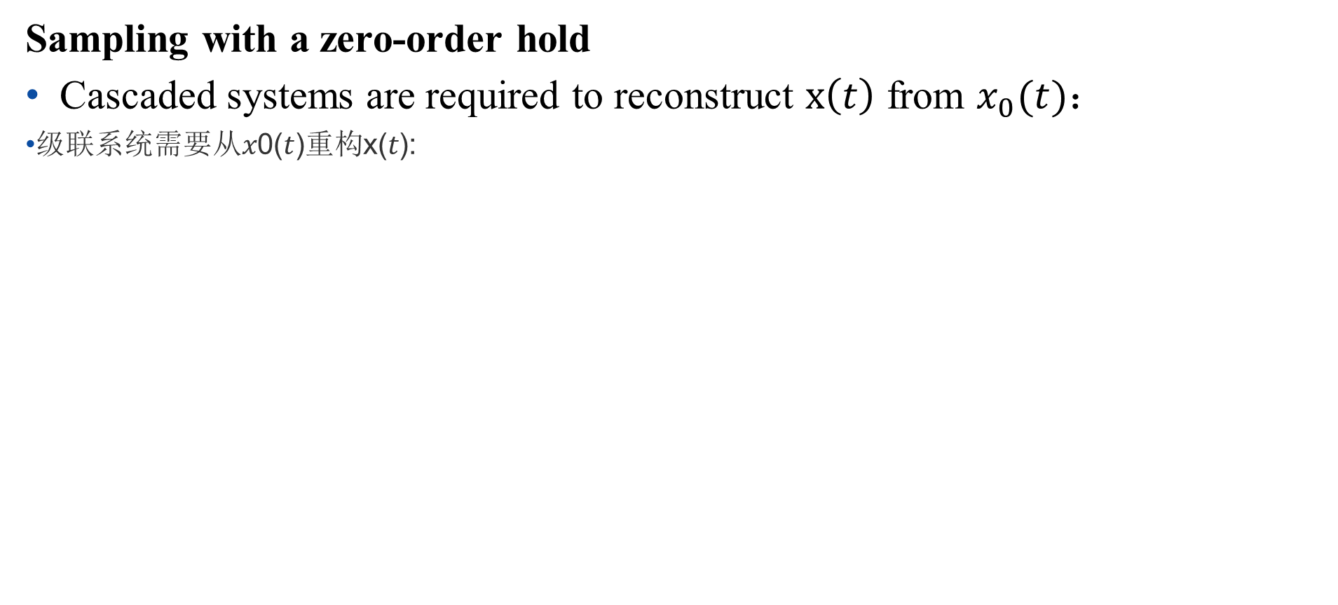
The Sampling Theorem
Sampling with a zero-order hold
Cascaded systems are required to reconstruct $x\left(t\right)$ from $x_{0}(t)$：
级联系统需要从𝑥0(𝑡)重构x(𝑡):

Slide 25
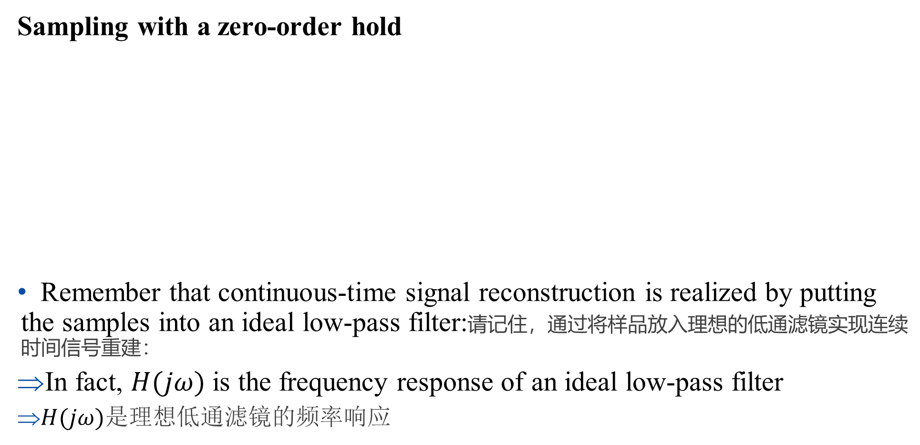
The Sampling Theorem
Sampling with a zero-order hold
Remember that continuous-time signal reconstruction is realized by putting the samples into an ideal low-pass filter:请记住，通过将样品放入理想的低通滤镜实现连续时间信号重建：
In fact, $H(jω)$ is the frequency response of an ideal low-pass filter
$H(jω)$是理想低通滤镜的频率响应

Slide 26
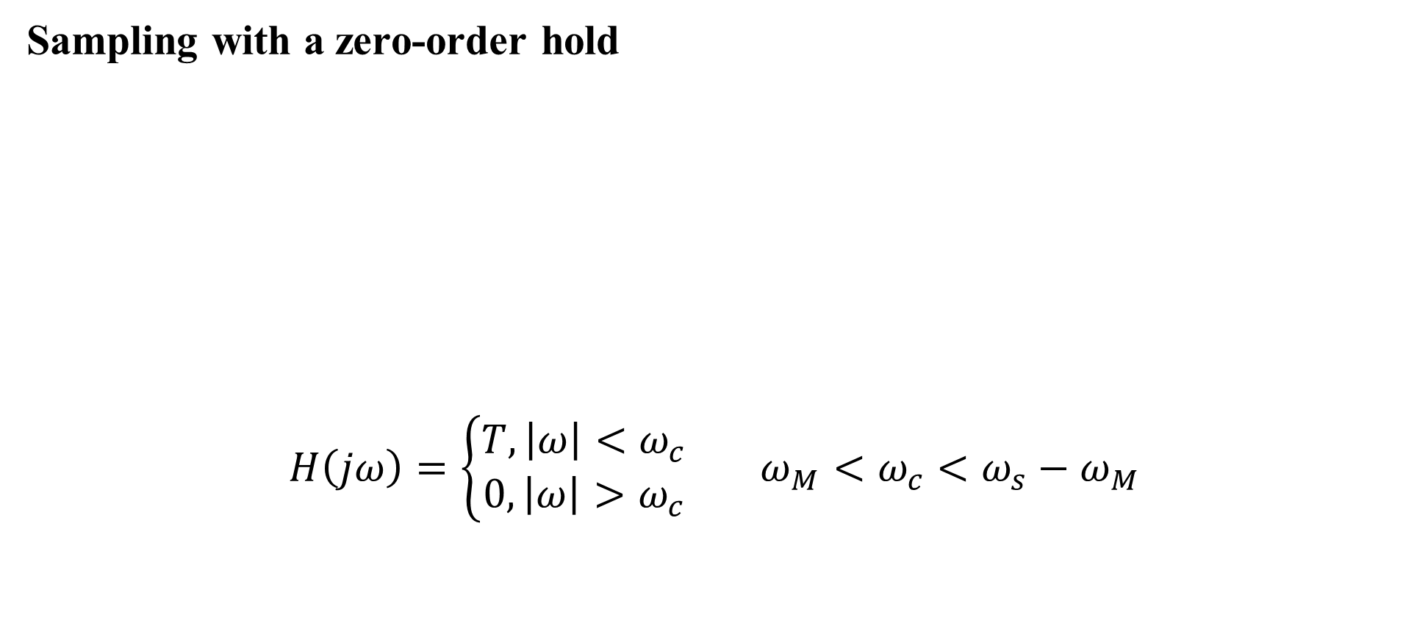
The Sampling Theorem
Sampling with a zero-order hold
$$H\left(jω\right)=\left\{\begin{aligned}T, \left|ω\right|<ω_{c} \\ 0,\left|ω\right|>ω_{c}\end{aligned}\right. ω_{M}<ω_{c}<ω_{s}−ω_{M}$$

Slide 27
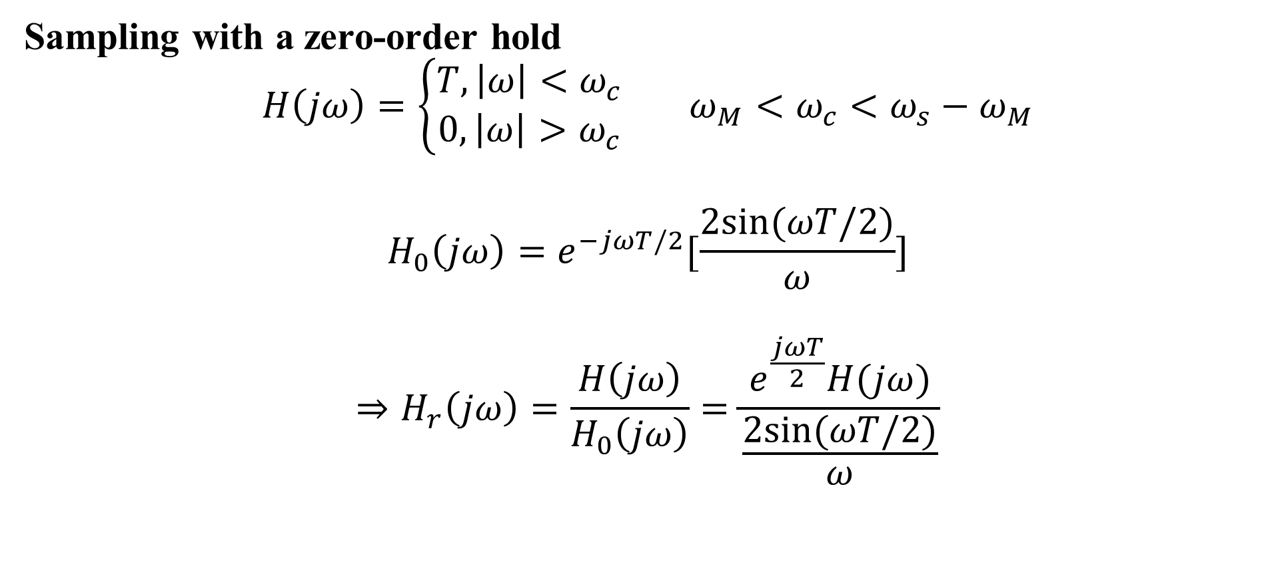
The Sampling Theorem
Sampling with a zero-order hold
$$H\left(jω\right)=\left\{\begin{aligned}T, \left|ω\right|<ω_{c} \\ 0,\left|ω\right|>ω_{c}\end{aligned}\right. ω_{M}<ω_{c}<ω_{s}−ω_{M}$$
$$H_{0}\left(jω\right)=e^{−jωT/2}[\frac{2sin⁡(ωT/2)}{ω}]$$
$$⇒H_{r}\left(jω\right)=\frac{H\left(jω\right)}{H_{0}\left(jω\right)}=\frac{e^{\frac{jωT}{2}}H(jω)}{\frac{2sin⁡(ωT/2)}{ω}}$$

Slide 28
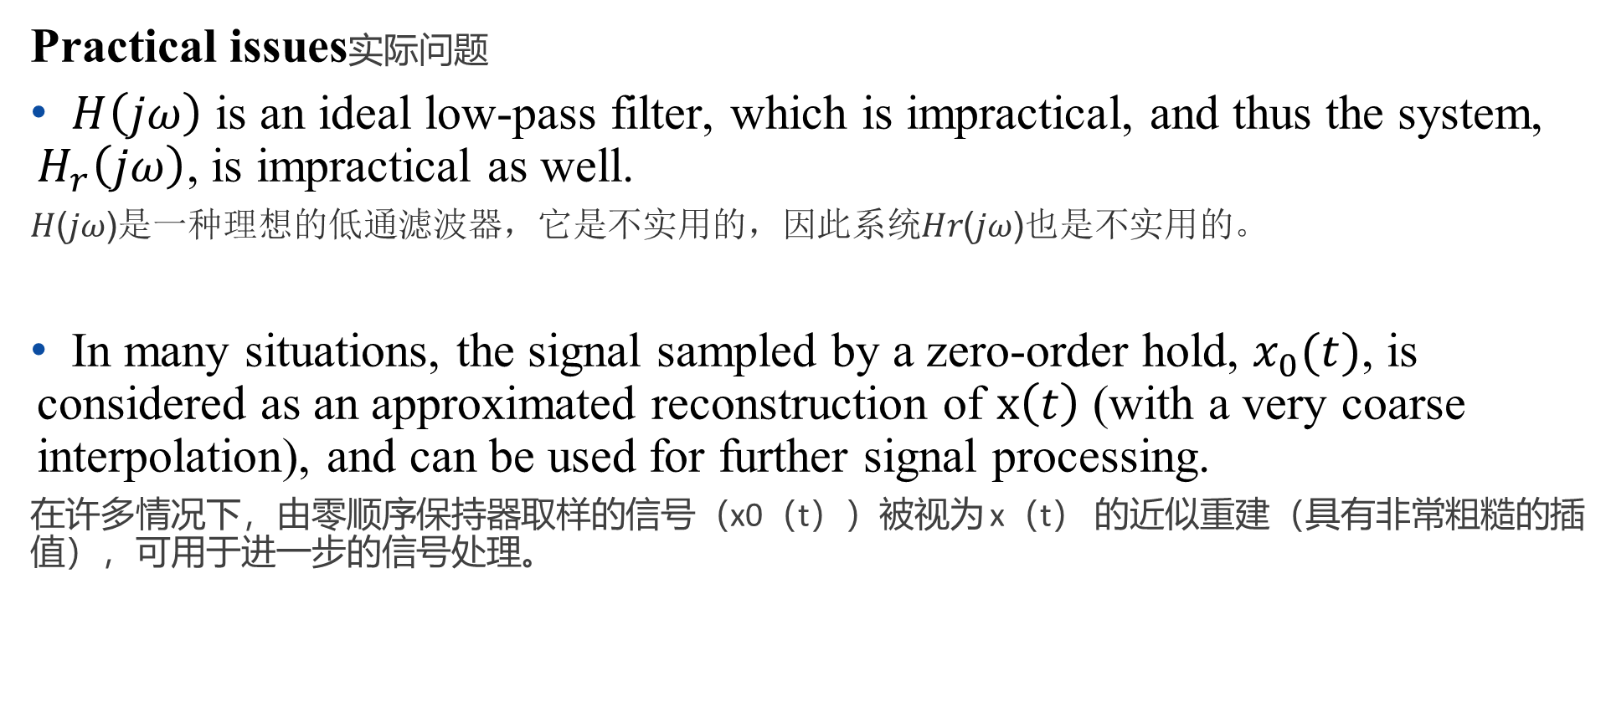
The Sampling Theorem
Practical issues实际问题
$H\left(jω\right)$ is an ideal low-pass filter, which is impractical, and thus the system, $H_{r}\left(jω\right)$, is impractical as well.
𝐻(𝑗𝜔)是一种理想的低通滤波器，它是不实用的，因此系统𝐻𝑟(𝑗𝜔)也是不实用的。
In many situations, the signal sampled by a zero-order hold, $x_{0}(t)$, is considered as an approximated reconstruction of $x\left(t\right)$ (with a very coarse interpolation), and can be used for further signal processing.
在许多情况下，由零顺序保持器取样的信号（x0（t））被视为 x（t） 的近似重建（具有非常粗糙的插值），可用于进一步的信号处理。

Slide 29
Outline: Lecture 7: Sampling
Introduction
The Sampling Theorem
Impulse train sampling
Sampling with a zero-order hold
Interpolation
Aliasing

Slide 30
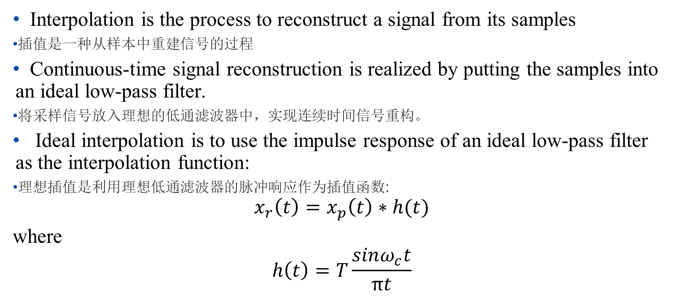
Interpolation
Interpolation is the process to reconstruct a signal from its samples
插值是一种从样本中重建信号的过程
Continuous-time signal reconstruction is realized by putting the samples into an ideal low-pass filter.
将采样信号放入理想的低通滤波器中，实现连续时间信号重构。
Ideal interpolation is to use the impulse response of an ideal low-pass filter as the interpolation function:
理想插值是利用理想低通滤波器的脉冲响应作为插值函数:
$$x_{r}\left(t\right)=x_{p}\left(t\right)∗h(t)$$
where
$$h\left(t\right)=T\frac{sinω_{c}t}{πt}$$

Slide 31
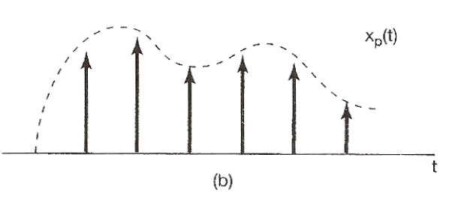
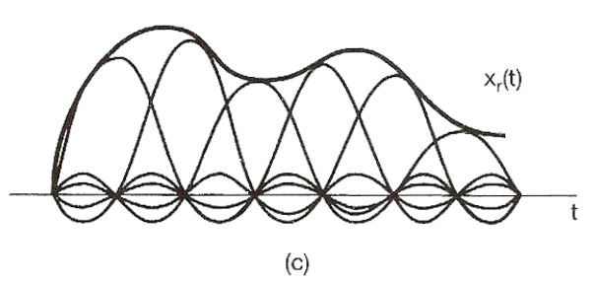
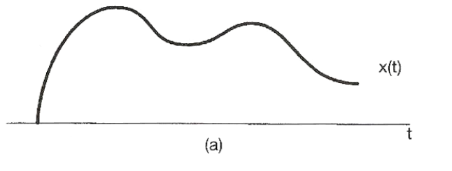
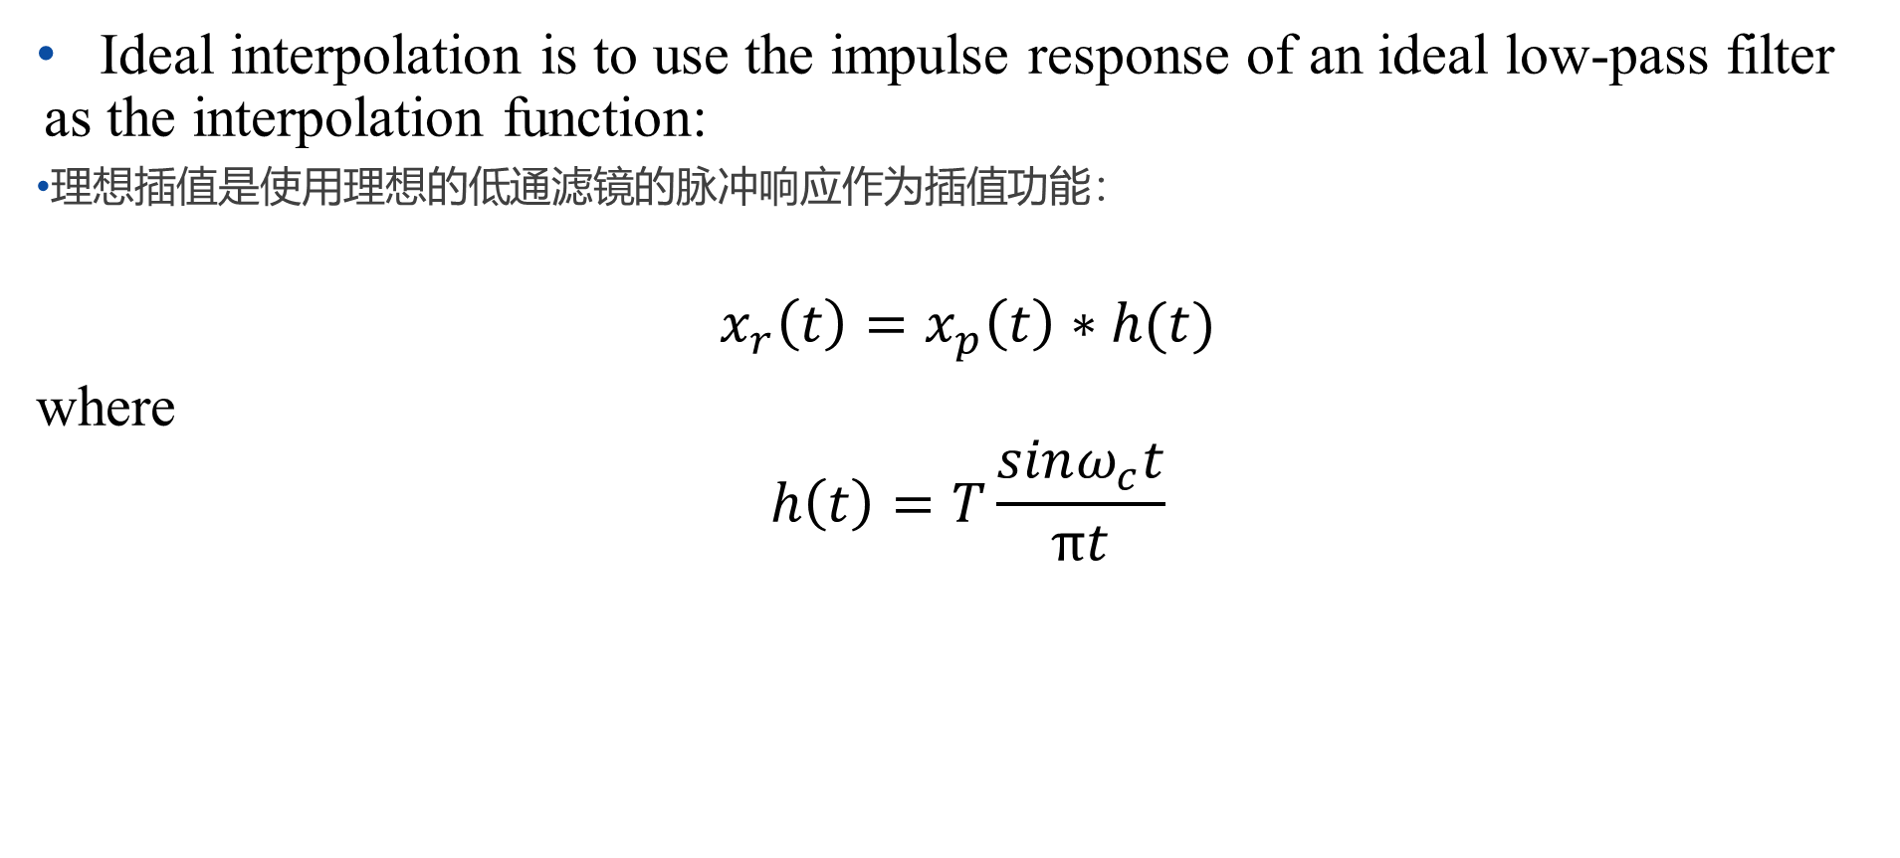
Interpolation
Ideal interpolation is to use the impulse response of an ideal low-pass filter as the interpolation function:
理想插值是使用理想的低通滤镜的脉冲响应作为插值功能：
$$x_{r}\left(t\right)=x_{p}\left(t\right)∗h(t)$$
where
$$h\left(t\right)=T\frac{sinω_{c}t}{πt}$$

Slide 32
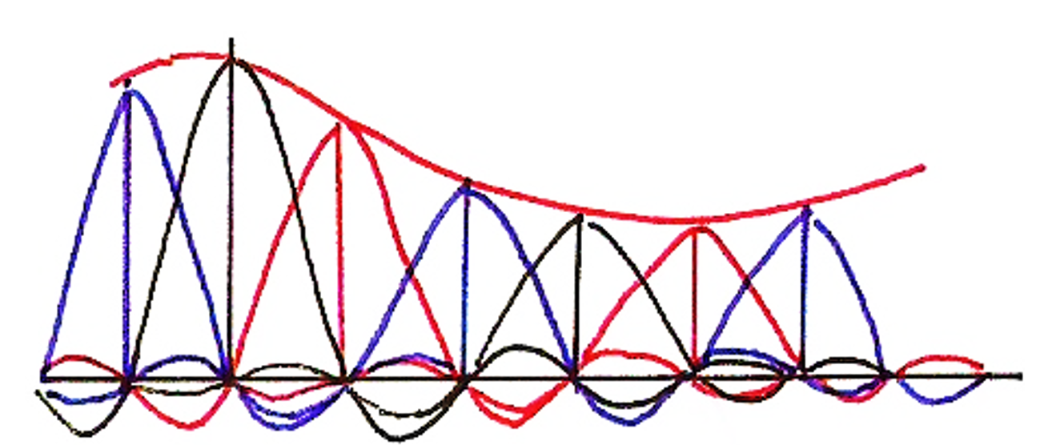
Interpolation
Ideal interpolation:理想的插值：

Slide 33
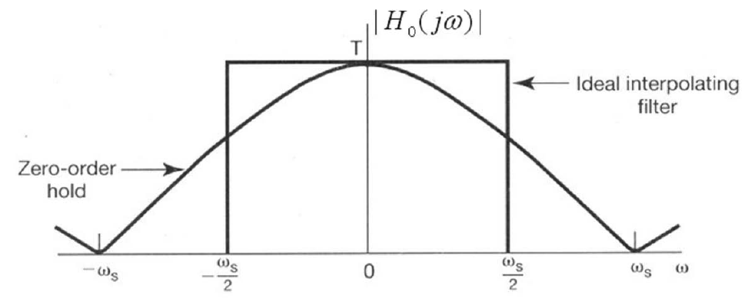
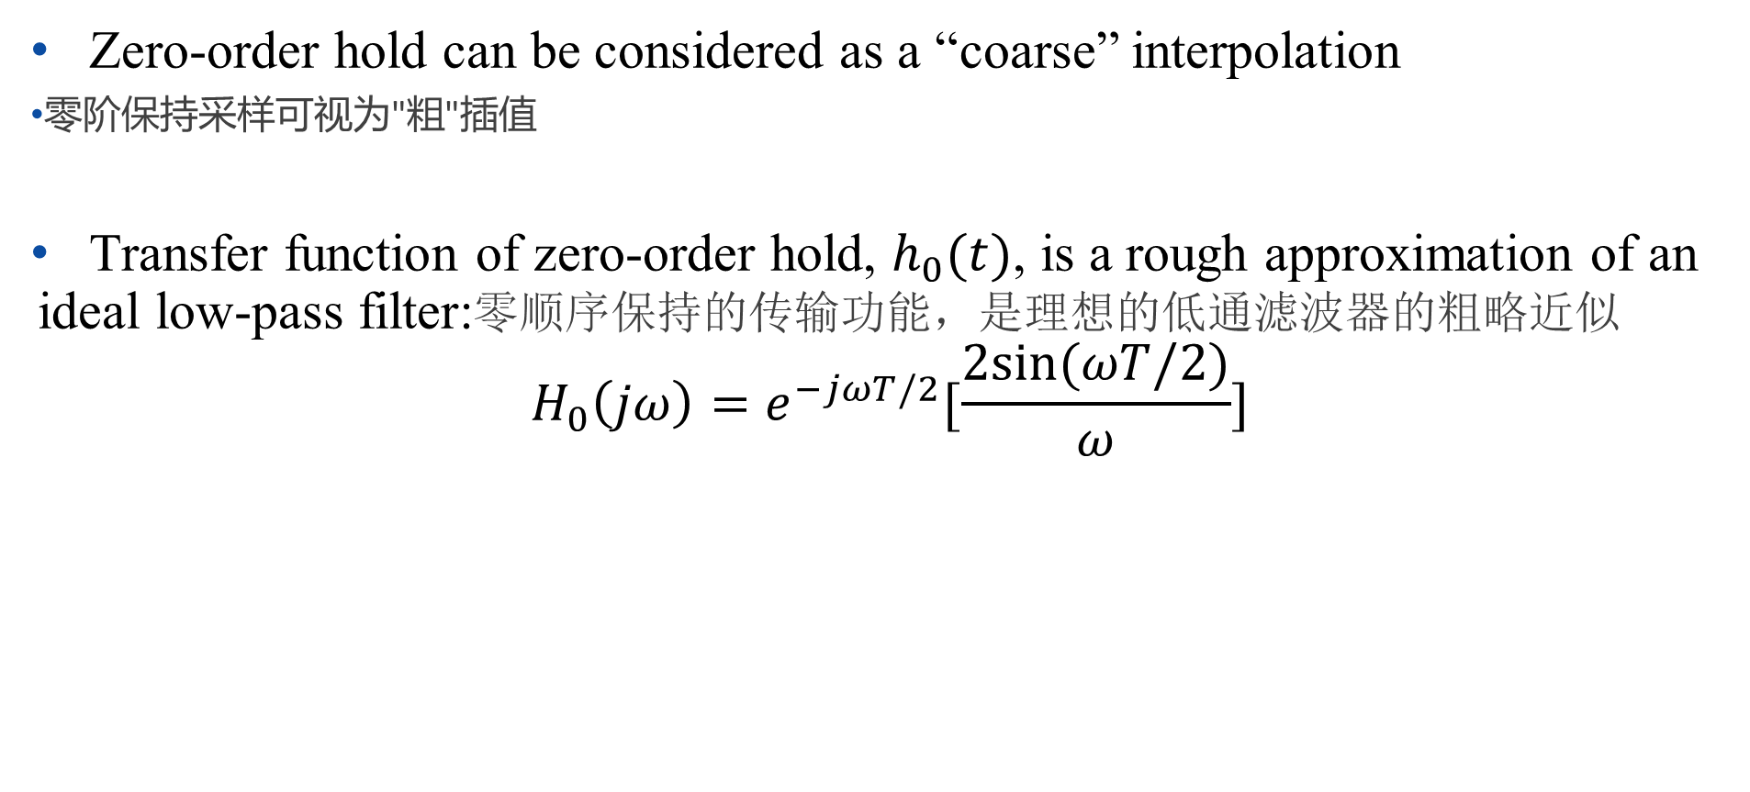
Interpolation（插值）
Zero-order hold can be considered as a “coarse” interpolation
零阶保持采样可视为"粗"插值
Transfer function of zero-order hold, $h_{0}(t)$, is a rough approximation of an ideal low-pass filter:零顺序保持的传输功能，是理想的低通滤波器的粗略近似
$$H_{0}\left(jω\right)=e^{−jωT/2}[\frac{2sin⁡(ωT/2)}{ω}]$$

Slide 34
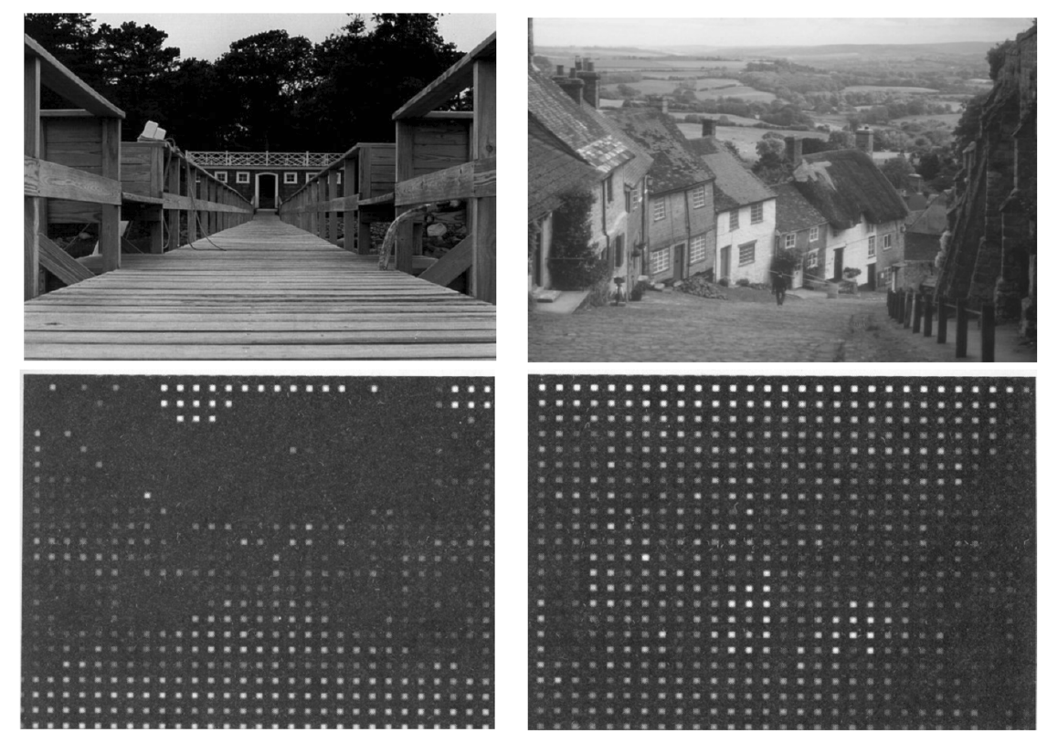
Interpolation
Original pictures:
Impulse train sampled pictures:
脉冲序列采样图像:

Slide 35
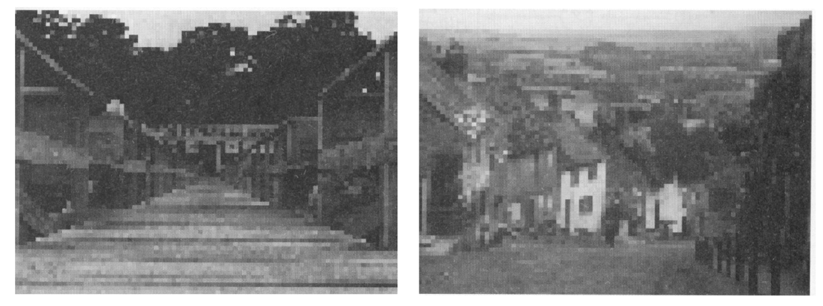
Interpolation
Original pictures:
Zero-order hold sampled pictures:
零阶保持采样图片:

Slide 36
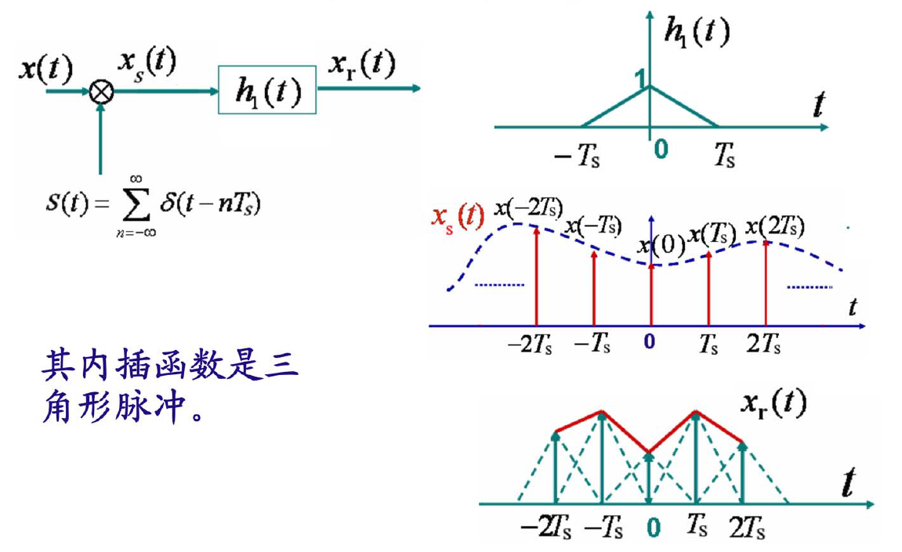
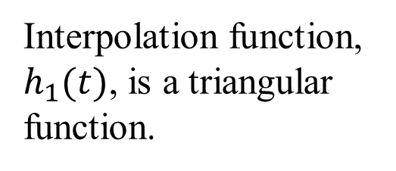
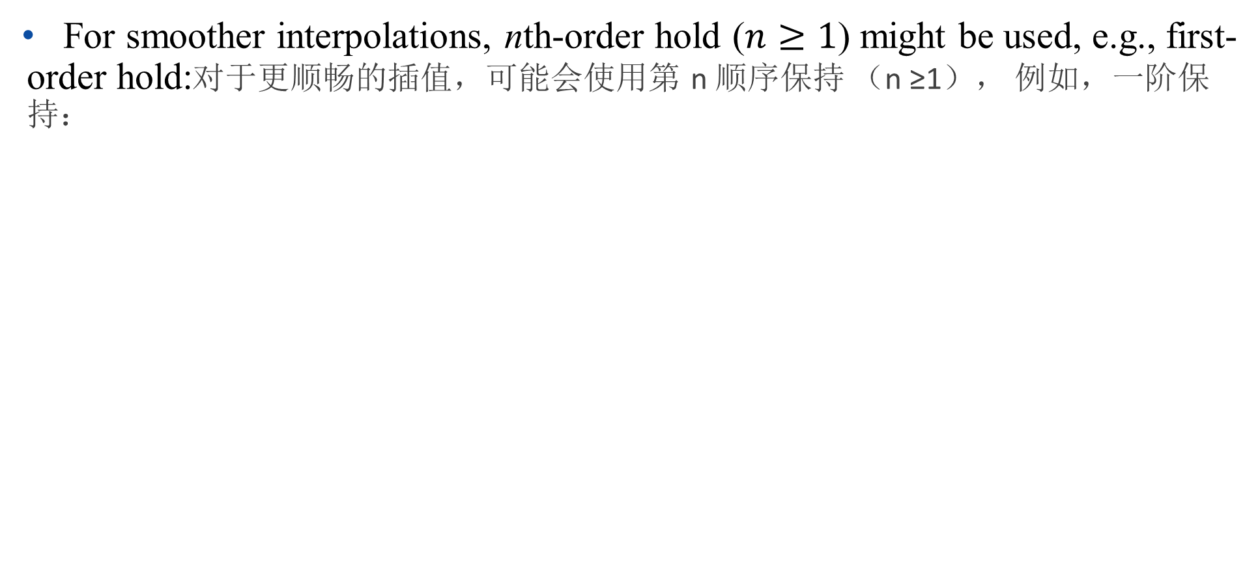
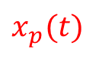
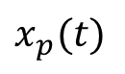
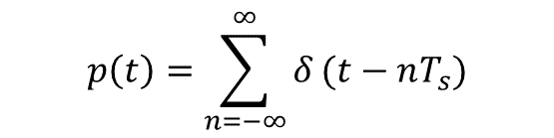
Interpolation
For smoother interpolations, nth-order hold ($n≥1$) might be used, e.g., first-order hold:对于更顺畅的插值，可能会使用第 n 顺序保持 （n ≥1）， 例如，一阶保持：
$$x_{p}(t)$$
$$p\left(t\right)=\sum_{n=−∞}^{∞}{δ}(t−nT_{s})$$
$$x_{p}(t)$$
Interpolation function, $h_{1}(t)$, is a triangular function.

Slide 37
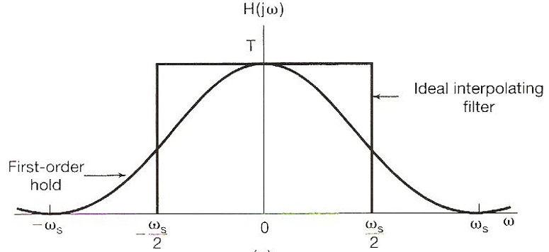
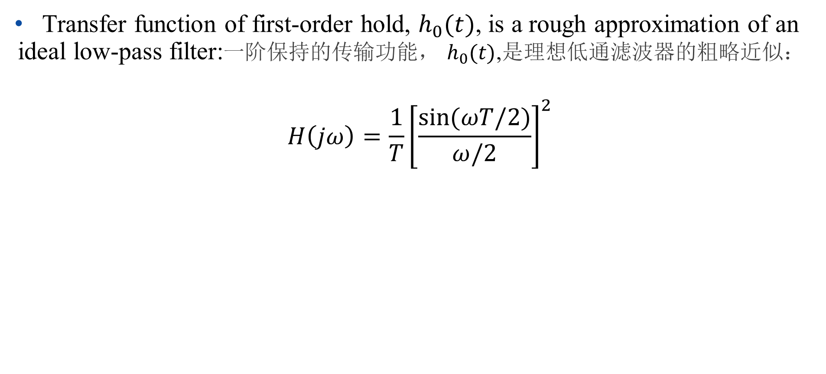
Interpolation
Transfer function of first-order hold, $h_{0}(t)$, is a rough approximation of an ideal low-pass filter:一阶保持的传输功能， $h_{0}(t)$,是理想低通滤波器的粗略近似：
$$H\left(jω\right)=\frac{1}{T}{\left[\frac{sin⁡(ωT/2)}{ω/2}\right]}^{2}$$

Slide 38
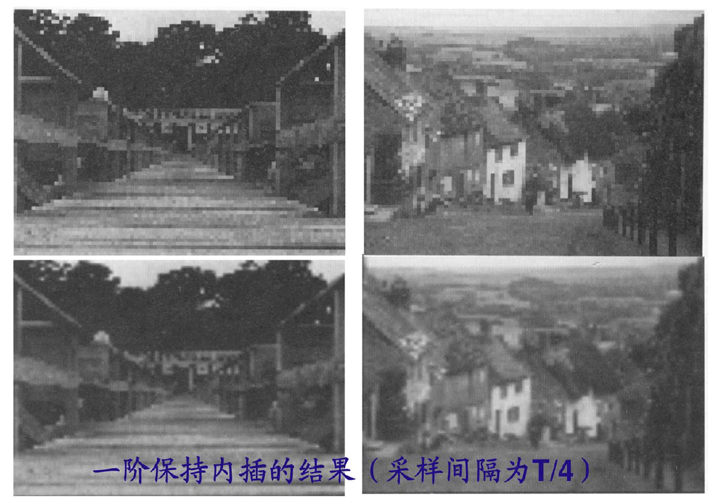
Interpolation
Zero-order hold sampled pictures:
First-order hold sampled pictures:
一阶保持采样图像

Slide 39
Outline: Lecture 7: Sampling
Introduction
The Sampling Theorem
Impulse train sampling
Sampling with a zero-order hold
Interpolation
Aliasing

Slide 40

Aliasing（混叠现象）
When $ω_{s}<2ω_{M}$, spectrum overlapped, frequency components confused, resulting in aliasing effect, such that the sampled signal can’t be reconstructed by low-pass filtering.当 $ω_{s}<2ω_{M}$时，频谱重叠，频率组件混淆，导致别名效果，因此取样信号无法通过低通滤重建。

Slide 41

Aliasing
Consider a signal $x\left(t\right)=cosω_{0}t$:
- sampled at sampling frequency（采样频率采样） $ω_{s}=\frac{2π}{T}$；
- reconstructed by an ideal low-pass filter with $ω_{c}=\frac{ω_{s}}{2}$ ;
（由理想的低通滤波器重建）
- reconstructed signal（重建信号）: $x_{r}\left(t\right)$
According to Nyquist sampling theorem, $x_{r}\left(t\right)=x\left(t\right)$ if $ω_{s}>2ω_{0}$

Slide 42




Aliasing
Assume a fixed $ω_{s}$, and vary $ω_{0}$:假设一个固定的𝜔_𝑠，并更改𝜔_0:
$$x\left(t\right)=cosω_{0}t$$
$$x_{r}\left(t\right)=cos⁡(ω_{s}{−ω}_{0})t$$

Slide 43

Aliasing
Assume $x\left(t\right)=cos⁡(ω_{0}t+φ)$
$$x\left(t\right)=\cos\left(ω_{0}t+φ\right)=\frac{1}{2}(e^{j\left(ω_{0}t+φ\right)}+e^{−j\left(ω_{0}t+φ\right)})$$
Using the Fourier transform:
$$e^{jω_{0}t} \underset{↔}{F}2πδ(ω−ω_{0})$$
$$e^{−jω_{0}t} \underset{↔}{F}2πδ(ω+ω_{0})$$
And the time shift property:以及时移性质: $x(t−t_{0})\underset{↔}{F}e^{−jωt_{0}}X(jω)$

Slide 44

Aliasing
Using the Fourier transform:
$$e^{j\left(ω_{0}t+φ\right)+} \underset{↔}{F}2πδ(ω−ω_{0})e^{jφ}$$
$$e^{−j\left(ω_{0}t+φ\right)} \underset{↔}{F}2πδ(ω+ω_{0})e^{−jφ}$$
$$\cos\left(ω_{0}t+φ\right)\underset{↔}{F}πe^{jφ}δ\left(ω−ω_{0}\right)+πe^{−jφ}δ\left(ω+ω_{0}\right)$$

Slide 45

Aliasing
$$x\left(t\right)=\cos\left(ω_{0}t+φ\right)\underset{↔}{F}X\left(jω\right)=πe^{jφ}δ\left(ω−ω_{0}\right)+πe^{−jφ}δ\left(ω+ω_{0}\right)$$
After feeding the samples into low-pass filter, $ω_{0}$ and ${−ω}_{0}$ components become $ω_{0}−ω_{s}$ and ${ω_{s}−ω}_{0}$ components, respectively.
将样品送入低通滤波器后， $ω_{0}$和${−ω}_{0}$分别变成$ω_{0}−ω_{s}$和${ω_{s}−ω}_{0}$

Slide 46

Aliasing
$$x\left(t\right)=\cos\left(ω_{0}t+φ\right)\underset{↔}{F}X\left(jω\right)=πe^{jφ}δ\left(ω−ω_{0}\right)+πe^{−jφ}δ\left(ω+ω_{0}\right)$$
$$X_{r}\left(jω\right)=πe^{jφ}δ\left(ω−{(ω}_{0}−ω_{s})\right)+πe^{−jφ}δ\left(ω+{(ω}_{0}−ω_{s})\right)$$
$$⇒ x_{r}\left(t\right)=\cos\left((ω_{0}−ω_{s})t+φ\right)$$

Slide 47

Aliasing
$$x\left(t\right)=\cos\left(ω_{0}t+φ\right), x_{r}\left(t\right)=\cos\left((ω_{0}−ω_{s})t+φ\right)$$
Even if $ω_{s}=2ω_{0},$ phase is changed (reversed):
$$x_{r}\left(t\right)=\cos\left(−ω_{0}t+φ\right)=\cos\left(ω_{0}t−φ\right)$$
The original signal cannot be reconstructed even if the sampling frequency is exactly twice of the highest frequency of the signal.（即使采样频率正好是信号最高频率的两倍，也无法重建原始信号。）
Nyquist sampling theorem: in order to precisely reconstruct a continuous-time signal, the sampling frequency has to be larger than twice of the highest frequency of the signal.（奈奎斯特采样定理：为了精确重建连续时间信号，取样频率必须大于信号最高频率的两倍。）

Slide 48
Thank you for your listening!

